Slide 1

JEDI BootCamp
Presented By: Jedi 01

Slide 2





TEAM JEDI 01
Harshil Bhavsar
Utkarsh Parkhi
Nishita Singh
Froz Husain
Shreyas Jain
‹#›

Slide 3
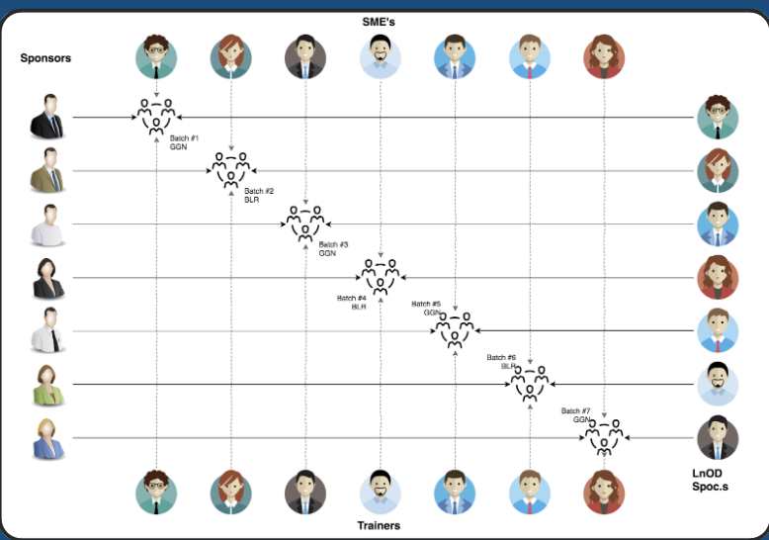
Stakeholders
Sponsors
Flipkart
SMEs
Amit Balyan
Order Trainer
khusboo
Sakshi
Deepika

Slide 4
Agenda
01
Our Journey
02
Our Team
03
Problem Statement
04
Engineering Practices
05
Tech Stack
06
Development
07
Challenges & Learnings
08
Demo
Questions
09

Slide 5
OUR JOURNEY

Slide 6
Framework for 8 days
REST API
&
Project Migration
DropWizard
&
Project Migration
5
6
Java Basics
&
Backend Code
3
4
MySQL
And JDBC
Linux Commands
GIT Commands
SDLC
1
2
OOAD
UML Modelling

Slide 7
DropWizard Implementation
REST API Implementation using Jersey & Tomcat server
Java Implementation
Making corresponding UML Artifacts
Understanding the Problem Statement

Slide 8
Problem Statement

Slide 9
To develop a course registration system for a universities which can be accessed by students, professors and Admins of the system.
These are the different features offered to different types of user:
Student
Register
Apply for Different courses
Get grades
Fees payment

Slide 10
Professors
Grade the students enrolled in their courses.
Choose the subjects to teach
Admins
Manage users
Manage courses
Approve students for course registration.
Approve courses selected by student

Slide 11
Engineering Practices
Product Thinking
Quick Decision Making
Test Driven Development
Continuous Improvement

Slide 12


Slide 13





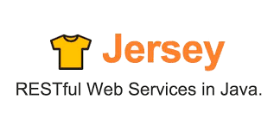


Slide 14

DEVELOPMENT

Slide 15
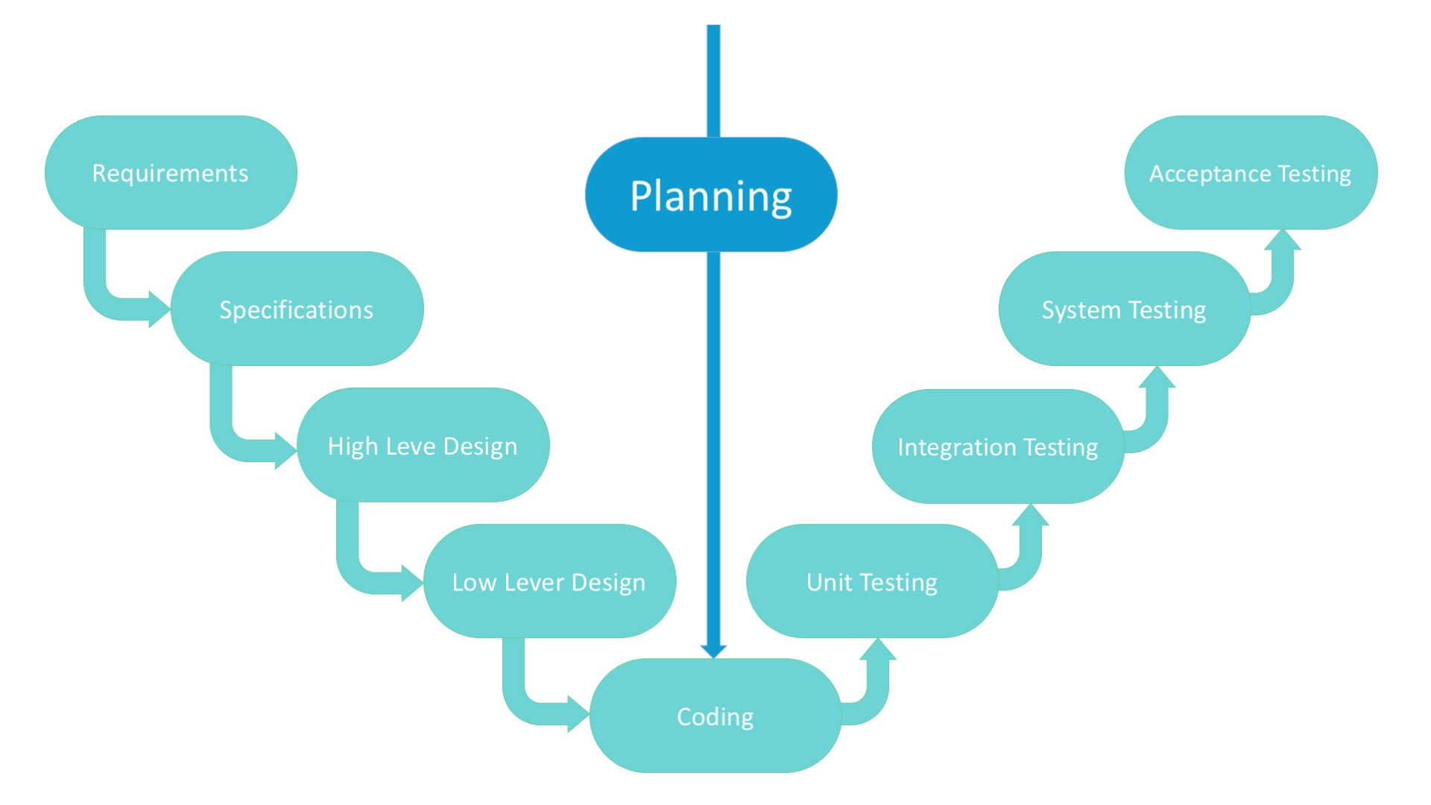
V-Shaped Software Development Life Cycle Model

Slide 16

System Architecture
HTTP
Request
HTTP
Response
Database
Postman
Java Rest Application class
Service class
Database Class
‹#›

Slide 17

LEARNING & CHALLENGES

Slide 18
Learnings
Got familiarized with Linux commands
Basic Git commands
Software Development Life Cycles
Various UML Diagrams
Java features
Java 8 new features
Generation of Javadoc & basic application monitoring
Connect database to project
Integration of REST services with Java code using Tomcat and Jersey
DropWizard Integration
Postman client to test APIs
Teamwork and Code collaboration

Slide 19
CHALLENGES
Git merge conflicts
Migration of project from one tech stack to another
Understanding the requirement of client
Resolving error due to version mismatch among libraries
Database integration challenges

Slide 20

DEMO

Slide 21


